Slide 1

Genome annotation comparisons of the Drosophila genus
Authors: Cheukting Law, Changmin Yu and Yusef Paolo Rabiah

Slide 2
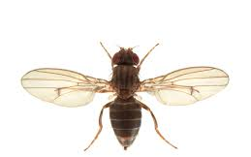
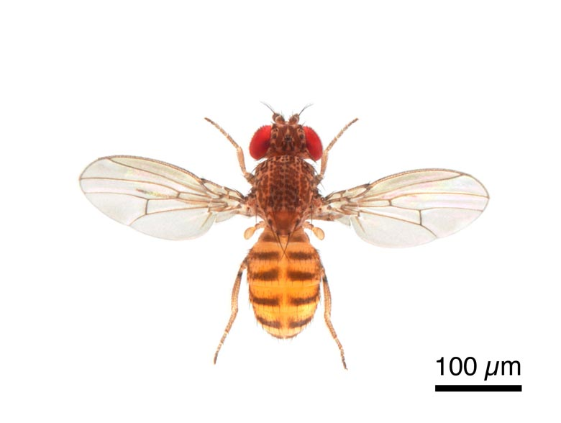
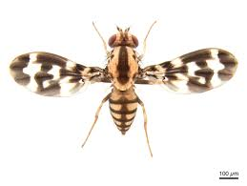
Drosophila species
Species studied:
D. grimshawi, D. virilis and D. mojavensis
Source: Flybase.org
Notes:
Drosophila grimshawi is a species of fruit fly from Hawaii
Drosophila virilis is a species of fruit fly with a worldwide distribution (probably due to human movements),
Drosophila mojavensis is a cactophilic species of fruit fly from the southwestern United States and Mexico,
All three species were part of a large genome comparative study of 12 fruit flies. (Drosophila 12 Genomes Consortium)

Slide 3
Annotation method: Genscan

Slide 4

Genscan ab initio gene prediction
Uses a probabilistic model to scan for core gene structural features within eukaryotic genomic sequences.
These include: promoters, exons, introns, donor and acceptor splice sites.
The model places emphasis on the gene features which are recognised by transcriptional, translational and splicing machinery.
Notes:
Doesn’t focus on specialised signals which are only present in particular genes. Won’t search for gene-specific transcription factor binding sites such as SP1 or E2F.
Focuses on generic core features including the TATA box, cap site and polyadenylation (AAUAAA) signals.
Drosophila core promoter database, 43% of core promoters contain a TATA box.
Advantages over Genie:
First, we use an explicitly double-stranded genomic sequence model in which potential genes occuring on both DNA strands are analyzed in simultaneous and integrated fashion. Second, while most existing integrated gene finding programs assume that in each input sequence there is exactly one complete gene, our model treats the general genscan model se in which the sequence may contain a partial gene, a complete gene, multiple complete (or partial) genes, or no gene at al
Restrictions of genscan:
Only protein coding genes are considered (no tRNA or rRNA genes included)
Transcription units are considered to be non-overlapping

Slide 5
Genscan preparation
Before insertion
The Drosophila scaffold FASTA files were split into 800,000 bp scaffolds upon insertion into Genscan.
Data filtering
Low-probability Genscan exon predictions (P < 0.50) are not reliable and have been removed.
Source: Genscan Manual

Slide 6

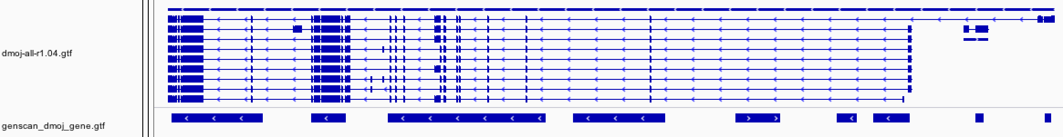
Genscan – Gene number
Key Conclusions:
Genscan overpredicts gene number in all studied Drosophila species
Reasons:
- Predicts non-existent genes
- Splits long genes into multiple smaller genes
Official gene regions
Predicted gene regions
Official gene regions
Predicted gene regions

Slide 7

Genscan – Gene length
Key Conclusions:
Gene lengths predicted by Genscan are shorter than the official gene lengths for all studied Drosophila species.
Observations:
- Majority of genes have lengths between 700 - 10,000bp.
- Concentration of data points lies slightly above the diagonal.
Reasons:
Genscan cannot predict 5’ and 3’ UTRs.
Log₁₀ (length of Genscan predicted genes)
Log₁₀ (length of Genscan predicted genes)
D. mog (official gene)
Genscan gene

Slide 8
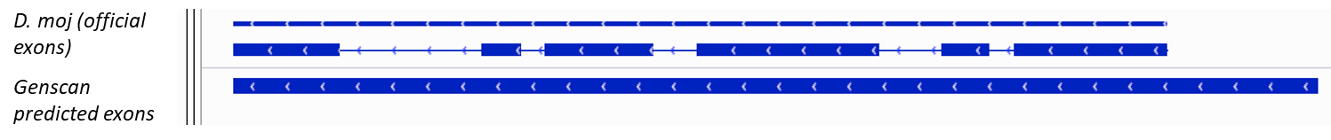
Genscan - Exon number
Key Conclusions:
Total exon number predicted by Genscan is less than the official total exon number for all studied Drosophila species.
Reasons:
- When there is a small intronic gap between two exons, Genscan experiences difficulties in detecting this intron and therefore predicts a single longer exon.
- Genscan has difficulties in resolving isoforms.

Slide 9
Genscan - Exon length
Key Conclusions:
- Predicted length of exons in Genscan has a localised cluster of data points on the diagonal in comparison with the length of the official exons.
Reasons:
- UTRs are not a contributing factor.
Log₁₀ (length of official exons)
Log₁₀ (length of Genscan predicted exons)

Slide 10
Gene number comparison in literature
Drosophila species | Genscan gene predictions | Coding Genes | Our Genscan predictions
D. grimshawi | 21,776 | 14,982 | 17,918
D. virilis | 22,393 | 14,491 | 19,711
D. mojavensis | 22,750 | 14,594 | 18,417
D. melanogaster | 18,548 | 13,918 | N/A
Source: Metazoa Ensembl

Slide 11
Annotation methods: Blastn and tBlastn

Slide 12
BLASTn and tBLASTn
Homology based methods
Query: D. melanogaster transcript and translate files respectively
Target: 3 Drosophila species’ genomes

Slide 13
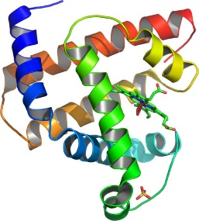
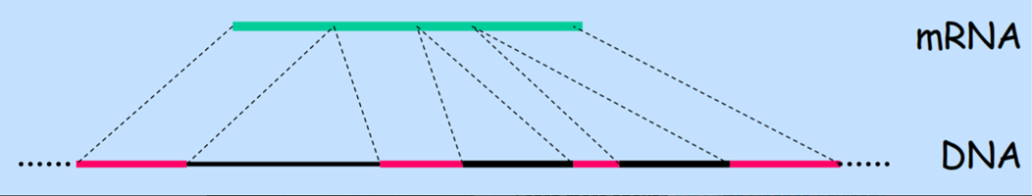
Blastn and tBlastn: Spliced alignment problem
Align mRNA sequences to the genomic DNA sequence of the 3 Drosophila species.
tBlastn
Blastn

Slide 14
GeneA
100
-
+
200
+
Gene
Strand
Exon cluster
-
4
1
2
3
Scaffold ID
Sum of Bit-score
1580
200
900
400
+
Gene A.1
Gene A.2
Gene A.3
Gene A.2
Sccaffold 100
-
Gene A.2
+
Sccaffold 200
-
Gene A. 1
tblastn/blastn predicted gene

Slide 15
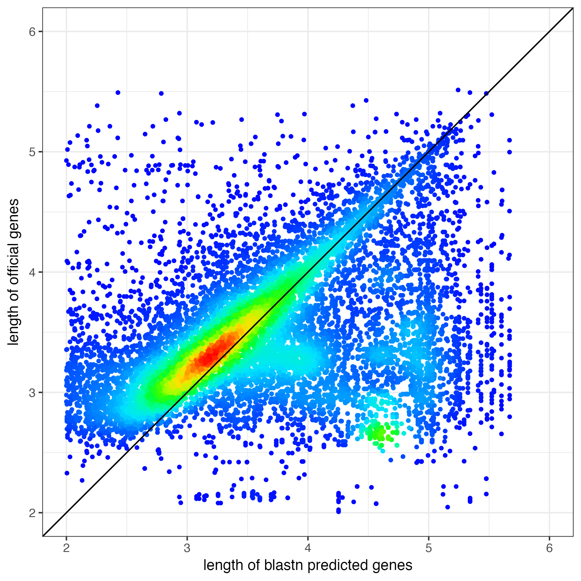
Blastn - Gene length
Key Conclusions:
Gene lengths predicted using Blastn are shorter than the official gene lengths for all Drosophila species.
Possible Reasons:
- Highly evolved UTRs prevent the sequences from aligning to the Drosophila genomes.
- The initial and terminal exons are not well predicted, shortening the gene length.
Log₁₀ (length of official genes)
Log₁₀ (length of Blastn predicted genes)

Slide 16
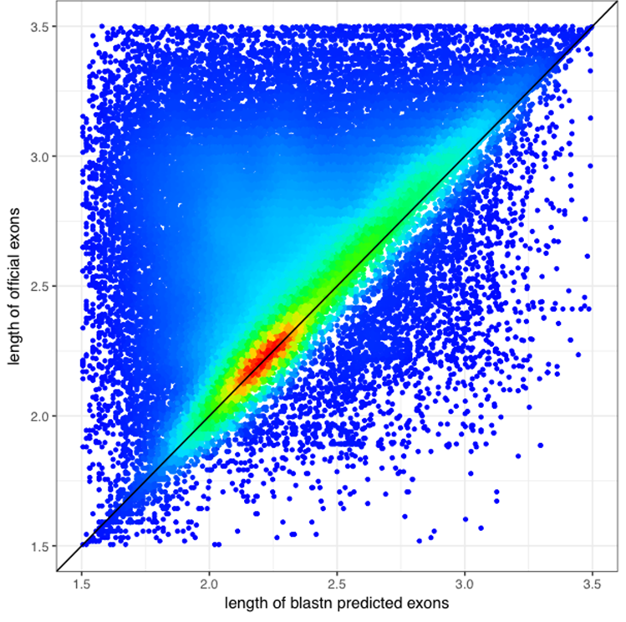
Blastn – Exon length
Key Conclusions:
Reasons:
-
Log₁₀ (length of official exons)
Log₁₀ (length of Blastn predicted exons)
Log₁₀ (length of Blastn predicted exons)

Slide 17
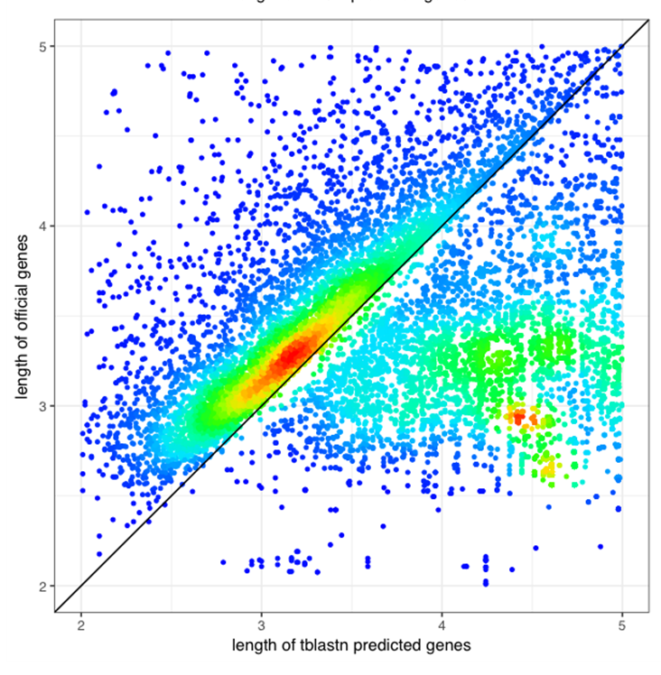
tBlastn – Gene length
Key Conclusions:
Reasons:
- UTRs are not accounted for
Log₁₀ (length of official genes)
Log₁₀ (length of tBlastn predicted genes)

Slide 18
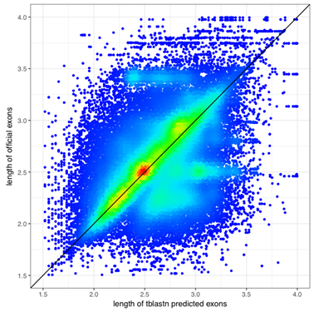
tBlastn - Exon Length
Key Conclusions:
-Exon length is evenly distributed along the diagonal
Reasons:
- UTRs are not accounted for
Log₁₀ (length of official exons)
Log₁₀ (length of tBlastn predicted exons)

Slide 19
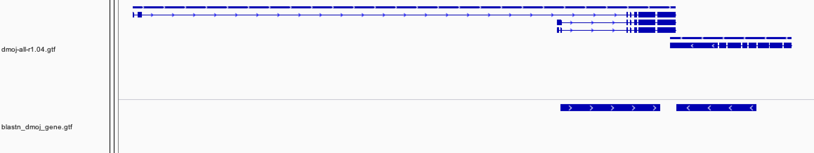
Blastn analysis overlap problem
Exon 1
Exon 2
Exon 3
Exon 4
Exon 5
Gene 1.1
Gene 1.1
Gene 1.2
Gene 1.3
Gene 1.1

Slide 20
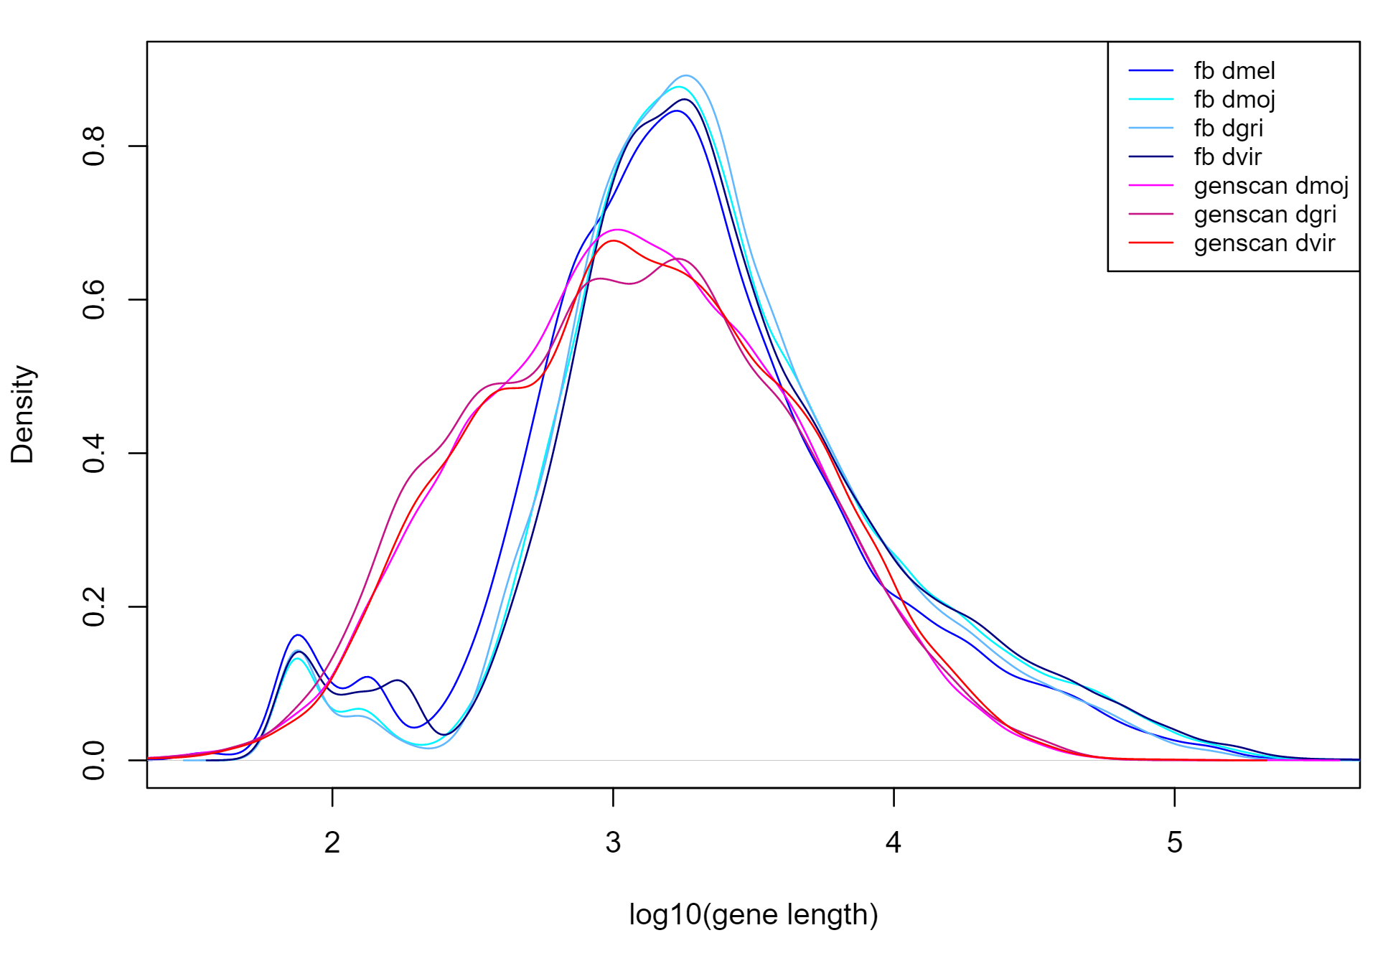
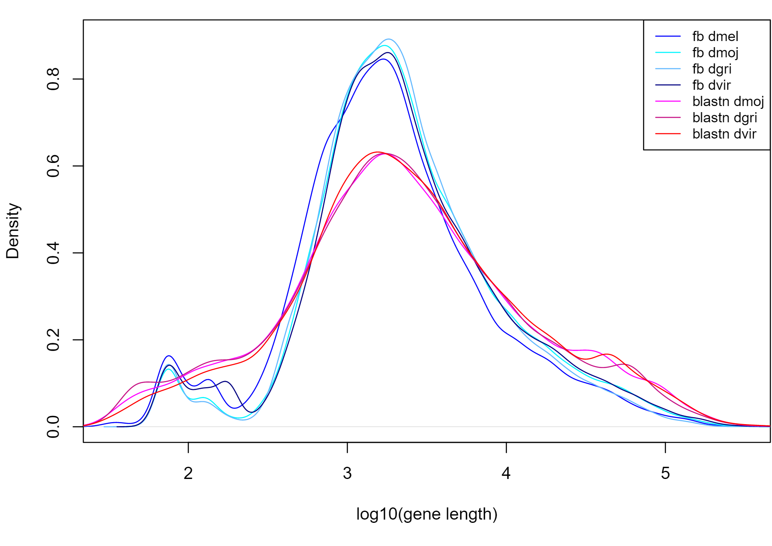
Gene length cross-species comparison
Distribution of gene length (Genscan)
Distribution of gene length (Blastn)
Notes:
Data is less clustered/centralised

Slide 21
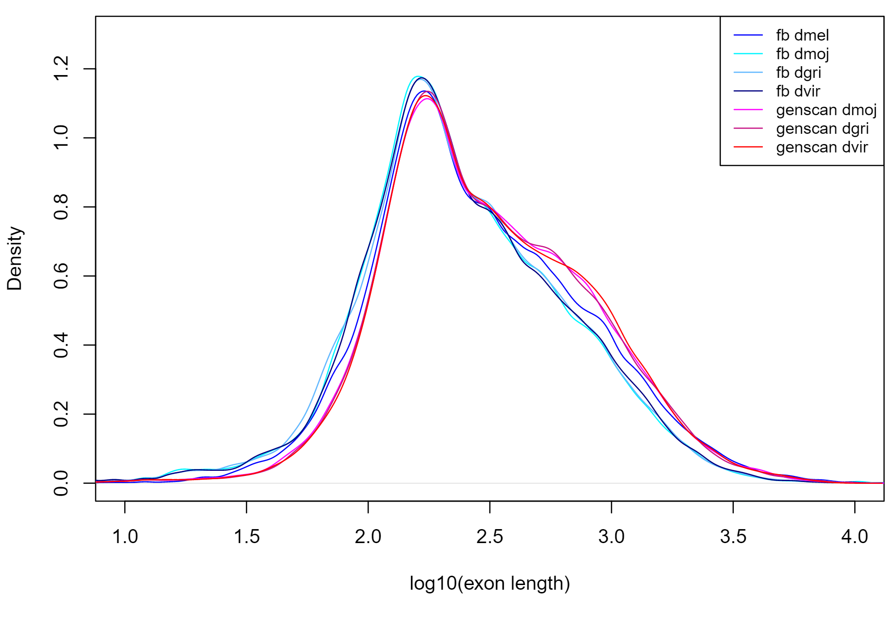
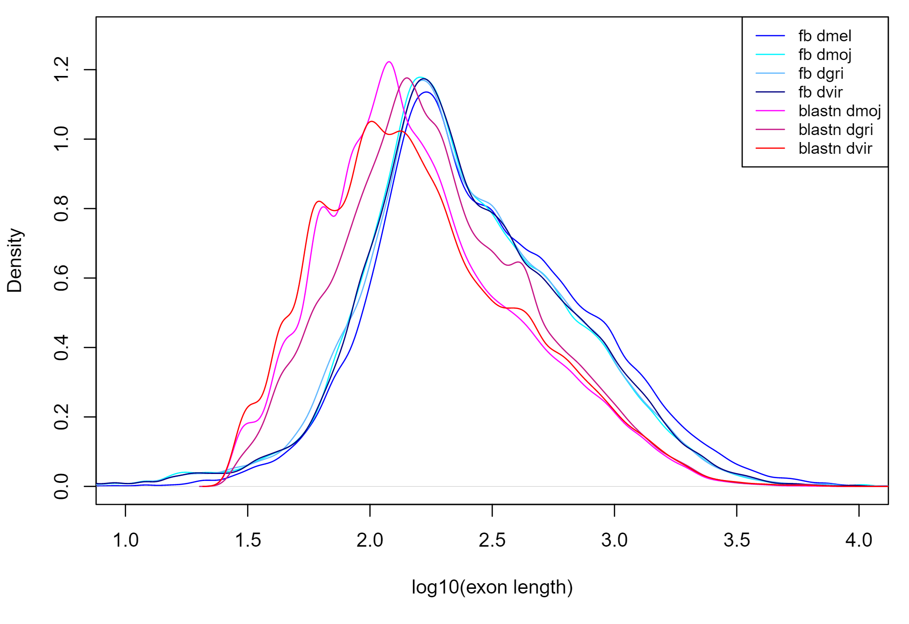
Exon length cross-species comparisons
Distribution of exon length (Genscan)
Distribution of exon length (Blastn)

Slide 22
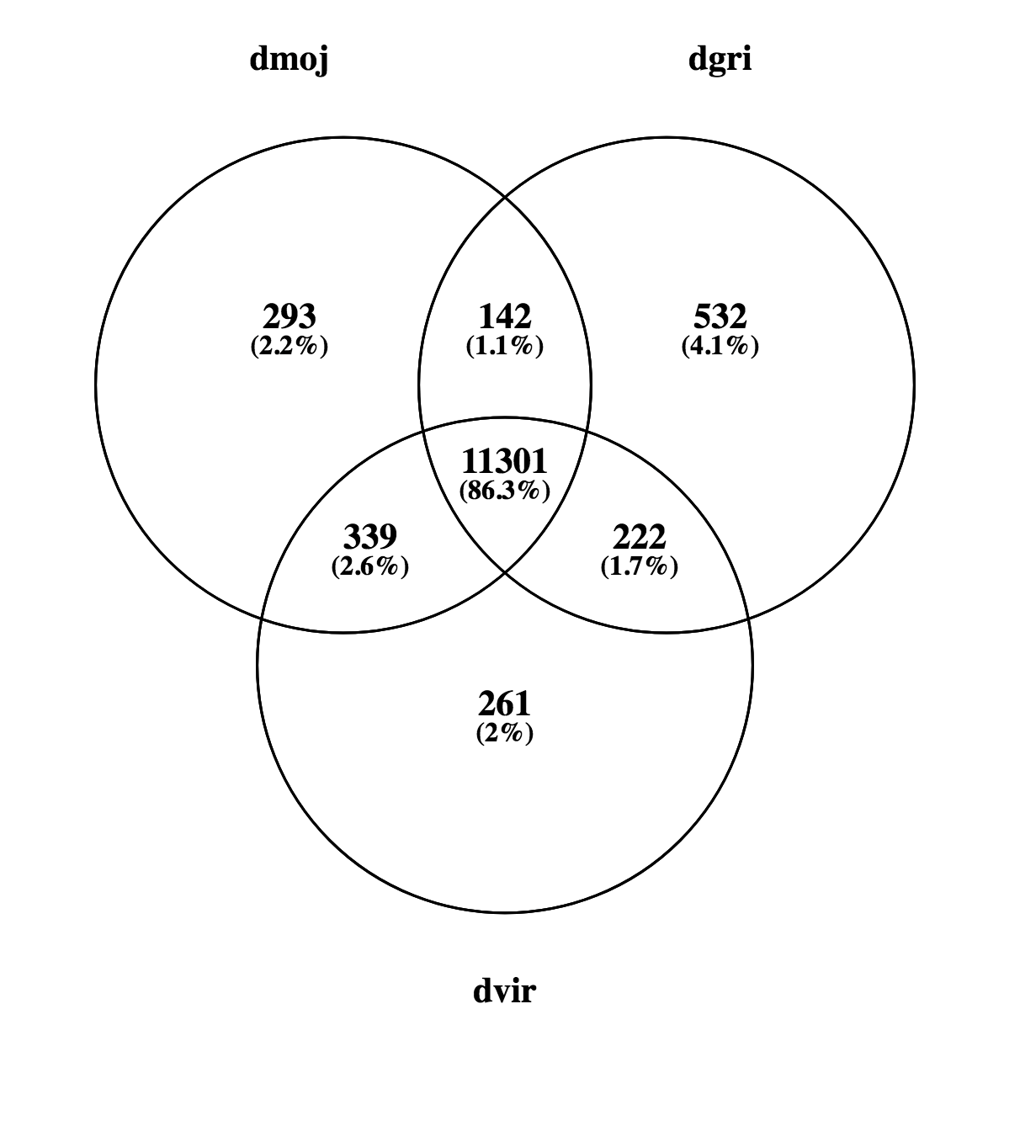
Venn Diagram

Slide 23
Conclusions
Both Genscan and Blastn/tBlastn have their advantages and disadvantages
Characteristics | Genscan | Blastn/tBlastn
Reference genome required | No | Yes
Functional annotations | No | Yes
Overprediction of gene number | Yes | No
Gene structure prediction | Yes | No
Isoform variants | No | Yes
An alternative method is to combine both methodologies (Twinscan)
Notes:
Genscan was trained on human and vertebrate training sets and so maybe is not as effective at ab initio prediction in invertebrate species.
Blastn used annotation by homology based alignment to look for similar matching sequences.
Genscan overpredicts genes
Genscan also splits long genes into small genes
Twinscan combines the information from predicted coding regions and splice sites with conserservation measurements between the target sequence and sequences from a closely related genome
Extends Genscan by allowing it to exploit to homology between two related genomes.
Twinscan combines the information from predicted coding regions and splice sites with conserservation measurements between the target sequence and sequences from a closely related genome
Twinscan demonstrates additional improved specificity and sensitivity in exon prediction, which can be accredited to modelling evolutionary conservation within genomic sequences.
Twinscan restriction is that it requires an informant genomic sequence of a closely related species to the target genome.

Slide 24
References and code files
References:
1) Burge, C. and Karlin, S. (1997). Prediction of complete gene structures in human genomic DNA. Journal of Molecular Biology, 268(1), pp.78-94.
2) Drosophila 12 Genomes Consortium, (2007). Evolution of genes and genomes on the Drosophila phylogeny, Nature, 450, 203-218.
3) Korf I, Flicek P, Duan D, Brent M. (2001). Integrating genomic homology into gene structure prediction. Bioinformatics, 17 , 140-148.
4) Gelfand, M. S., Mironov, A. A., & Pevzner, P. A. (1996). Gene recognition via spliced sequence alignment. Proceedings of the National Academy of Sciences of the United States of America, 93(17), 9061–9066.
5) James T. Robinson, Helga Thorvaldsdóttir, Wendy Winckler, Mitchell Guttman, Eric S. Lander, Gad Getz, Jill P. Mesirov. (2011). Integrative Genomics Viewer. Nature Biotechnology, 29, 24–26.
GitHub Address:
https://github.com/Cy1614/GIA

Slide 25
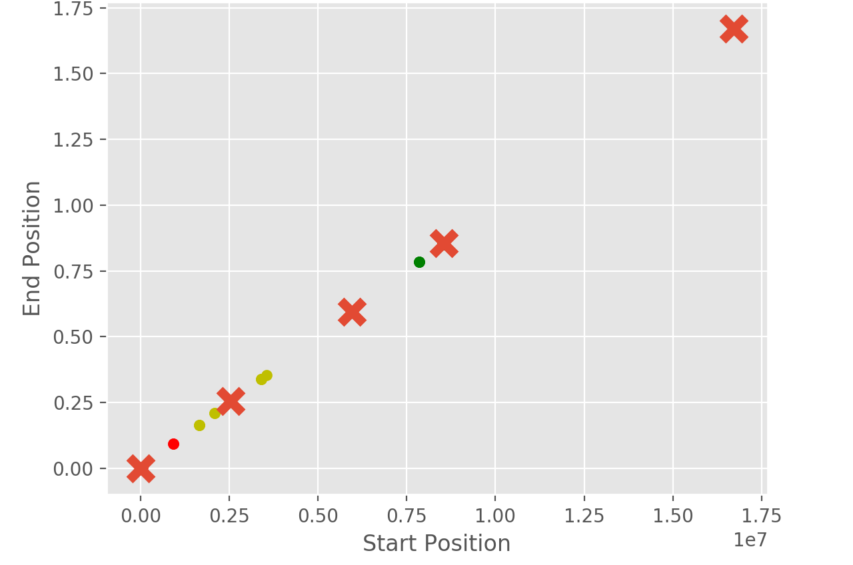
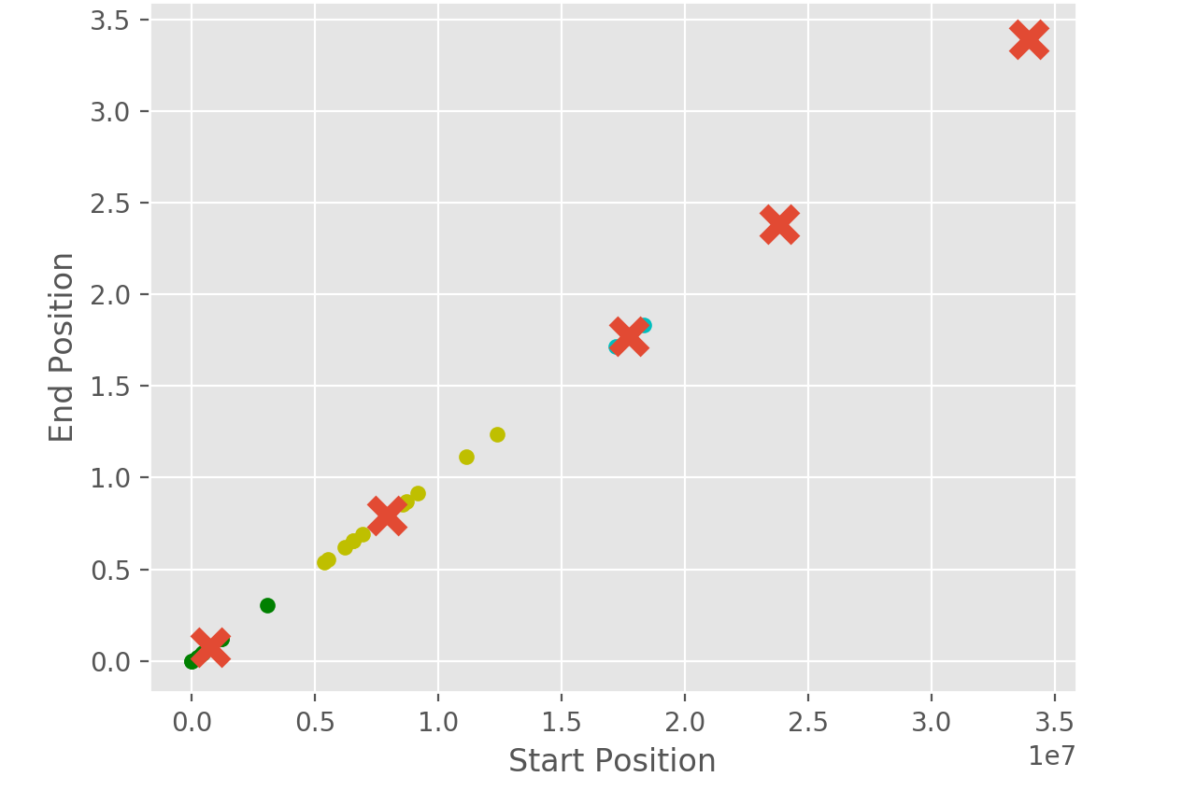
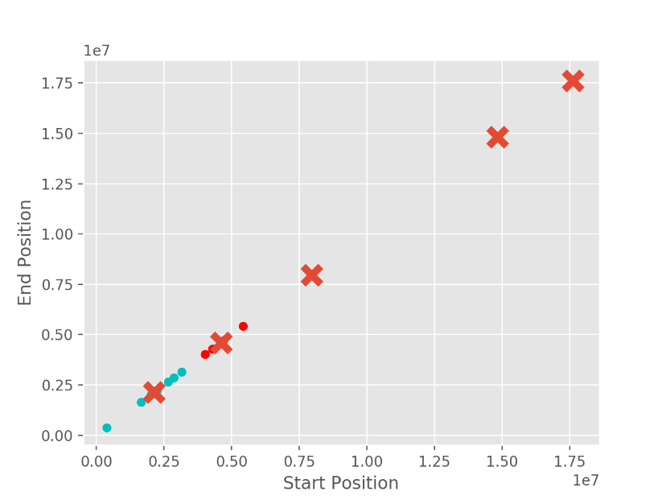
Clustering regions using machine learning
Hierarchical clustering -> K-Means clustering -> Further classify the correspondence using Bit Scores

